Slide 1
Real-time Video Streaming Server
Performance Report
Taopin
Dept. Computer, Tsinghua Univ.
Oct. 2002

Slide 2





Test flow
4.50-200 Client Agents…
Log Server
Media Data
RTSP Command
Performance Data
Disk Raid
Media Server

Slide 3
Our some test data(1)
3 different bit rate video streams (128kbps, 384kbps, 768kbps)
53 various parameters of 3 classes (cpu,network,disk)for each bit rate streams
10 different clients counts levels according the server’s capacity and the bit rate of streams
Total 49.2MB test data

Slide 4
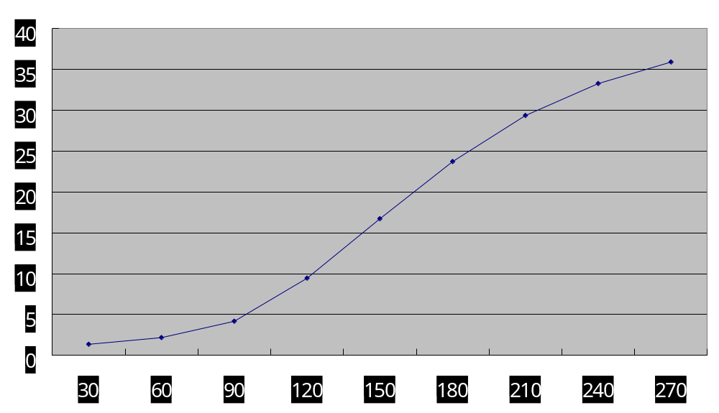
Our some test data (2)
128kbps Processor Time % (PentiumⅢ 933MHz)

Slide 5
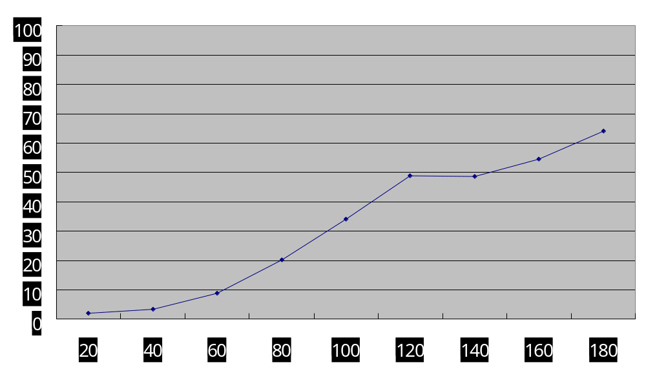
Our some test data (3)
384kbps Processor Time % (PentiumⅢ 933MHz)

Slide 6
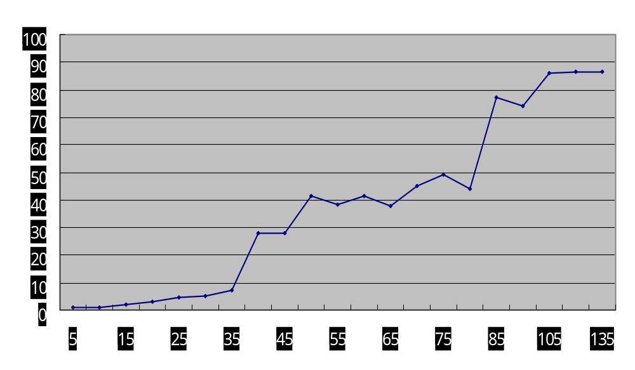
Our some test data (4)
768kbps Processor Time % (PentiumⅢ 933MHz)

Slide 7
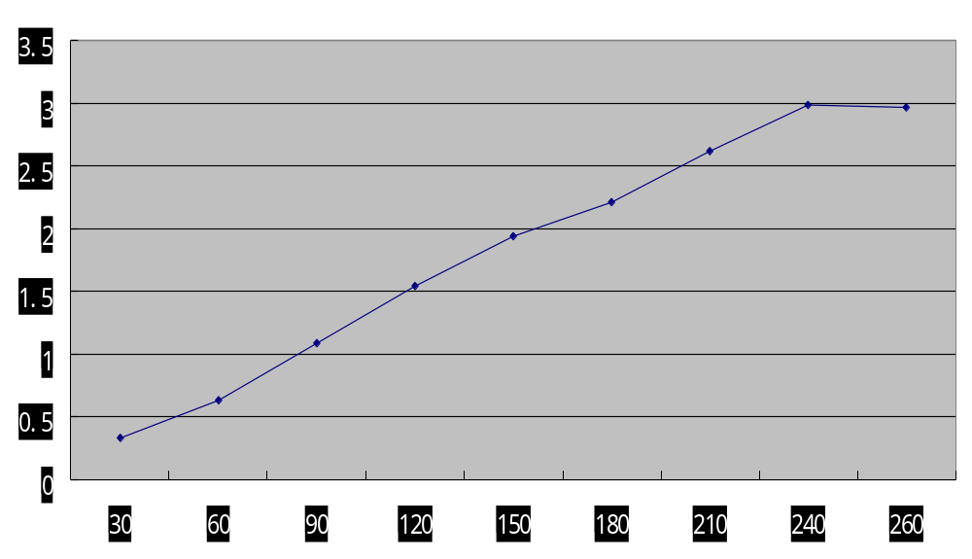
Our some test data (5)
128kbps Disc Read Million Bytes /s

Slide 8
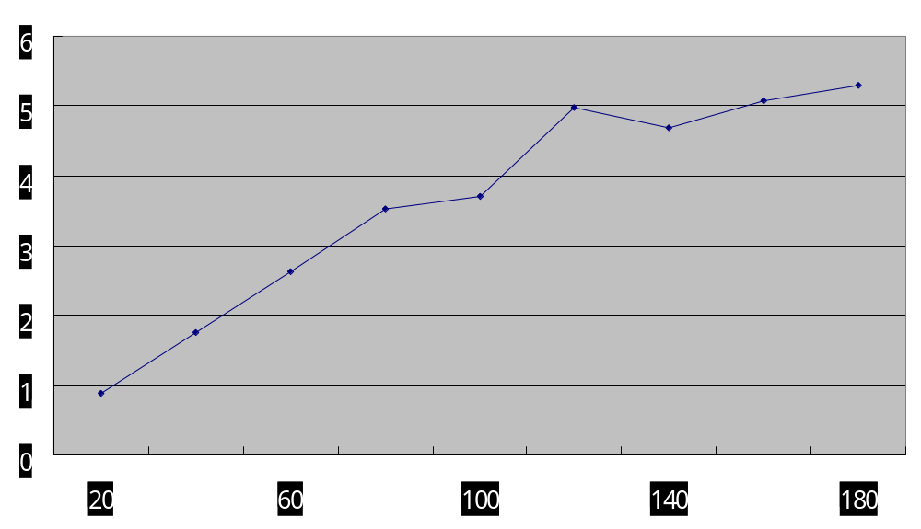
Our some test data (6)
384kbps Disc Read Million Bytes /s

Slide 9
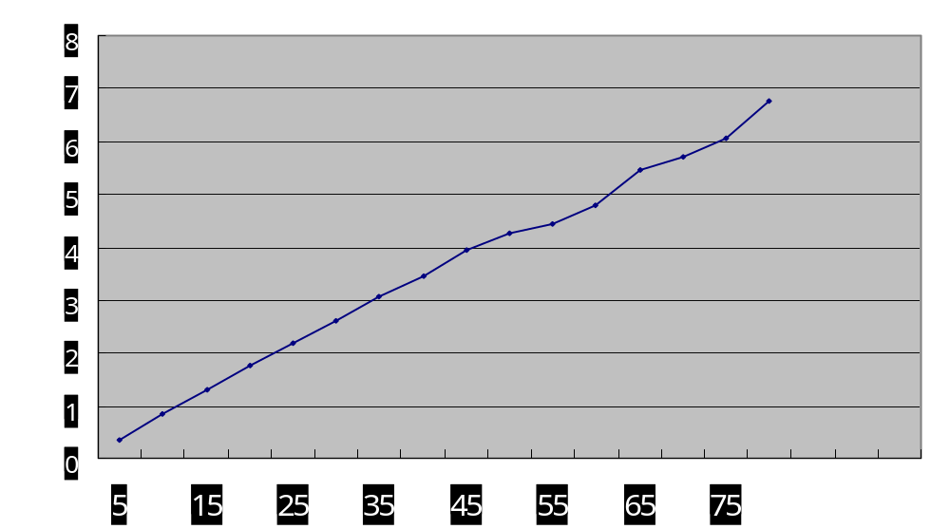
Our some test data (7)
768kbps Disc Read Million Bytes /s

Slide 10
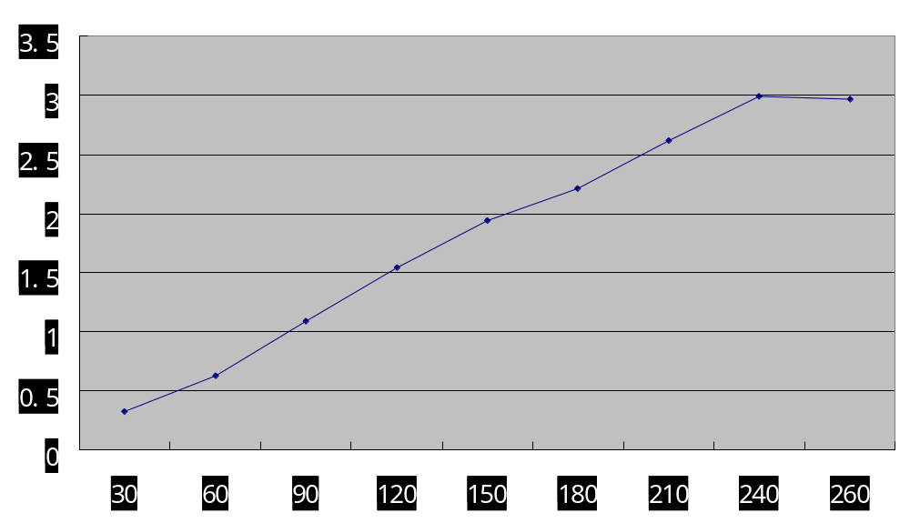
Our some test data (8)
128kbps Net Sent Million Bytes /s (Intel[R] PRO PCI Adapter 100M)

Slide 11
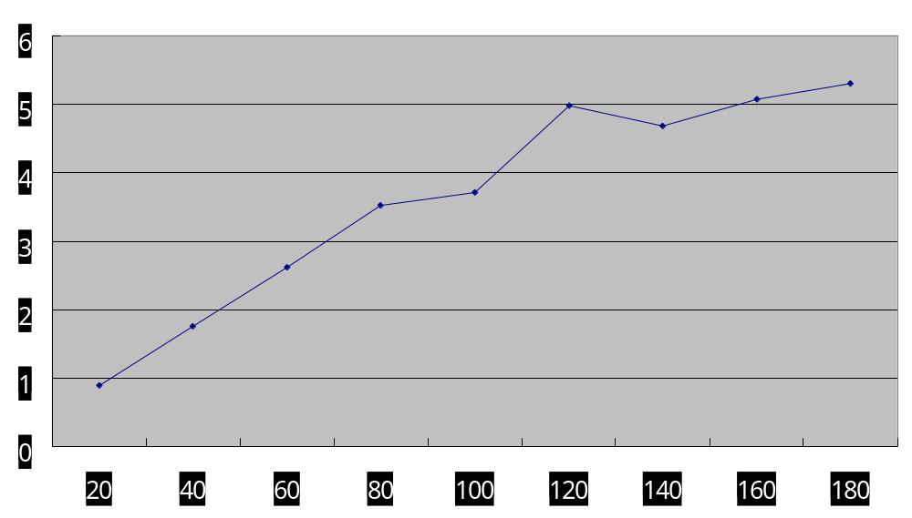
Our some test data (9)
384kbps Net Sent Million Bytes /s (Intel[R] PRO PCI Adapter 100M)

Slide 12
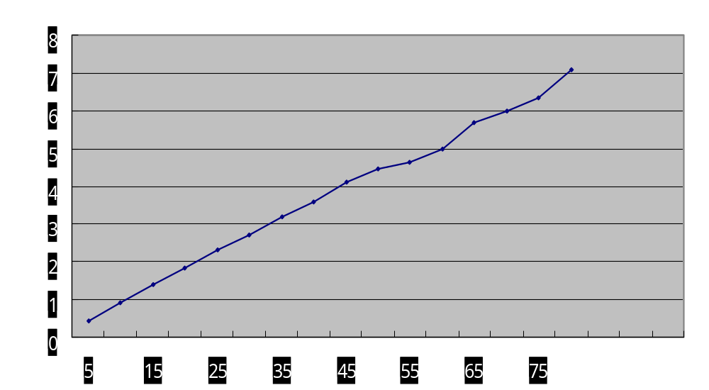
Our some test data (10)
768kbps Net Sent Million Bytes /s (Intel[R] PRO PCI Adapter 100M)

Slide 13
Conclusions
Before the payload reach the media server’s capacity limitation,the cost of the server’s resources increase linearly as the client number and media streams bit rate increase.
Network interface is the bottleneck of the Media Server

Slide 14
Thanks!

